Slide 1
Capstone Project
Bhaskar Subanji
NYC Taxi Trip Time Prediction Analysis

Slide 2
Content
Data Summary
Analysis Of Data
Challenges
Conclusion

Slide 3
Problem statement
Task is to build a model that predicts the total ride duration of taxi trips in New York City. Your primary dataset is one released by the NYC Taxi and Limousine Commission, which includes pickup time, geo-coordinates, number of passengers, and several other variables.We analysis which month has more trip

Slide 4
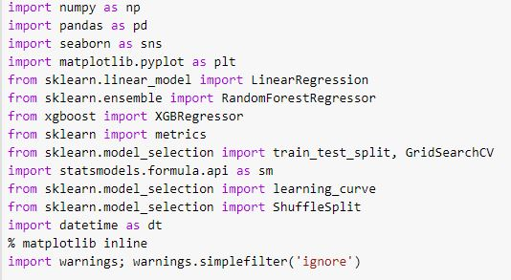
Python Modules/Packages/Libraries.
Let us begin our analysis by loading the above mentioned Python Modules/Packages/Libraries.

Slide 5
Data Summary
Data set name:-NYC Taxi Data.csv - the training set (contains 1458644 trip records)
The dataset is based on the 2016 NYC Yellow Cab trip record data made available in Big Query on Google Cloud Platform.
Shape :
Rows: 1458644
Columns: 11
Important Columns: [‘ id vendor_id pickup_datetime dropoff_datetime passenger_count pickup_longitude pickup_latitude dropoff_longitude dropoff_latitude store_and_fwd_flag trip_duration ]

Slide 6
DATA Description:
id - A unique id for each trip.
vendor_id - A code specifying the provider associated with the trip record.
pickup_datetime - Pick up date and time or Time of meter started.
dropoff_datetime - Dropped off date and time or Time of meter started.
passenger_count - Passenger count as entered by the driver.
pickup_longitude - Longitude details of Pick up or when the meter started.
pickup_latitude - latitude details of Pick up or when the meter started.
dropoff_longitude - Longitude details of dropoff or when the meter turned off.
dropoff_latitude - latitude details of dropoff or when the meter turned of
store_and_fwd_flag - This flag shows us, whether the trip record was held in vehicle memory before sending to the vendor because the vehicle did not have a connection to the server - Y=store and forward; N=not a store and forward trip.
trip_duration - Its our target variable and it is duration of the trip in seconds.

Slide 7
We will analyze each column label of the dataframe with respect to different variable and trip duration and try find the relation between them.

Slide 8
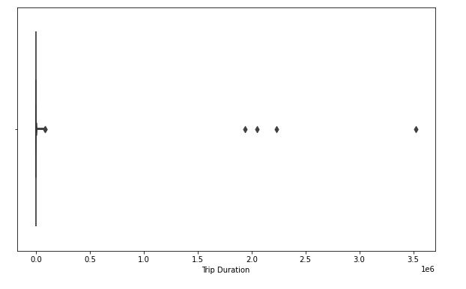
Analysis of trip duration

Slide 9
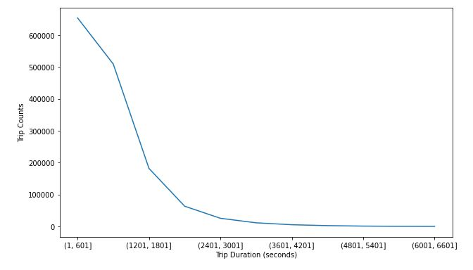
Analysis of trip duration with trip counts

Slide 10
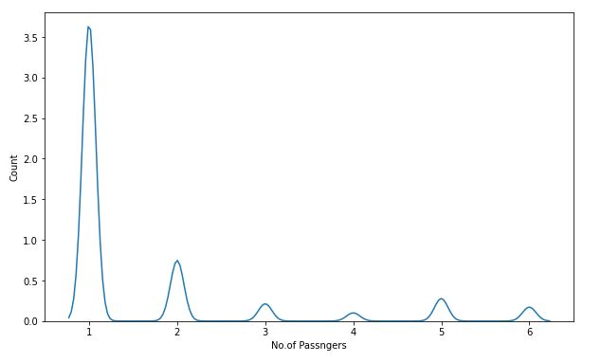
Analysis of passenger count

Slide 11
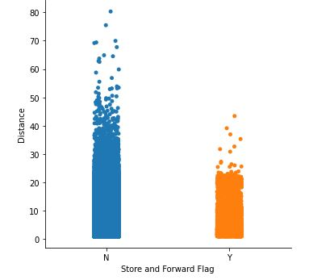
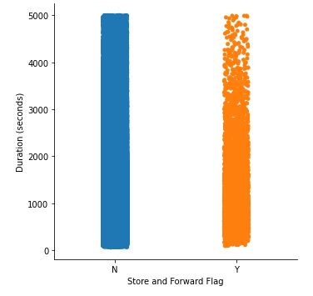
Analysis of Store & forward flag

Slide 12
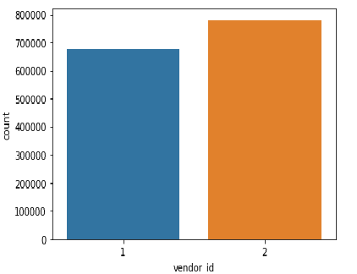
Analysis of vendor id

Slide 13
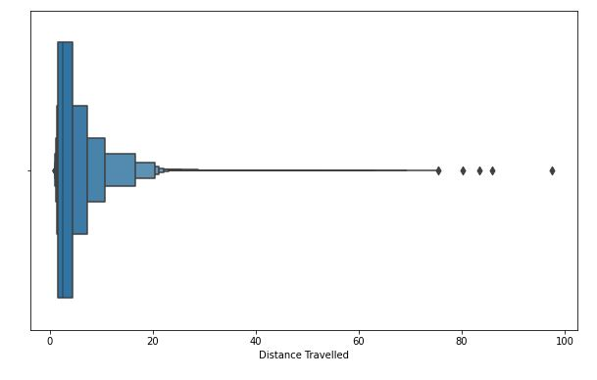
Analysis of distance

Slide 14
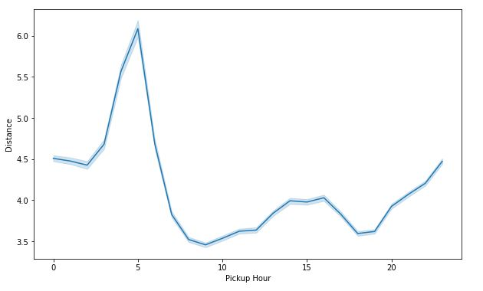

Slide 15
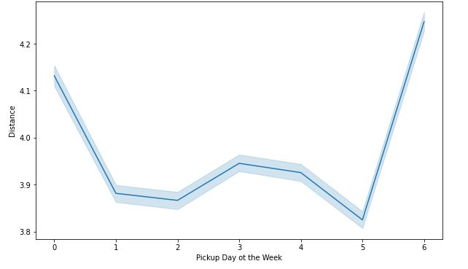

Slide 16
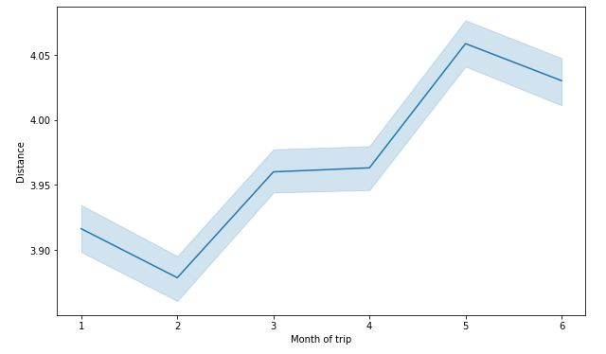

Slide 17
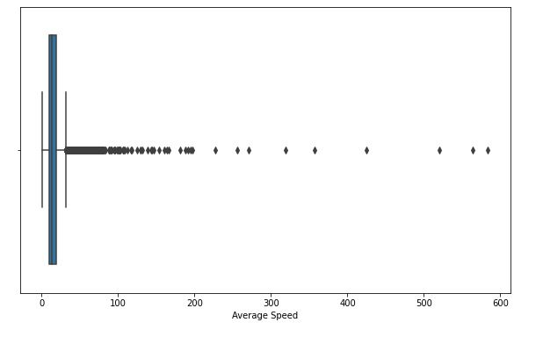
Analysis of speed

Slide 18
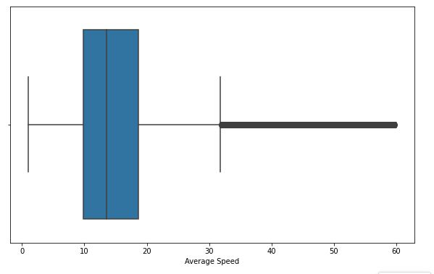

Slide 19
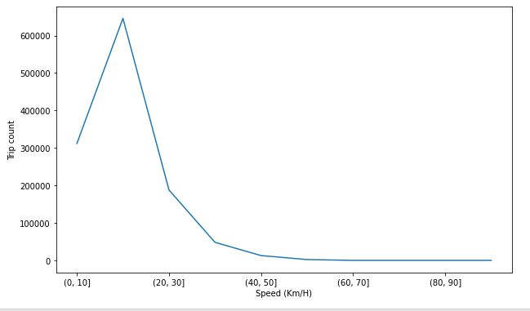
Trip count with average speed

Slide 20
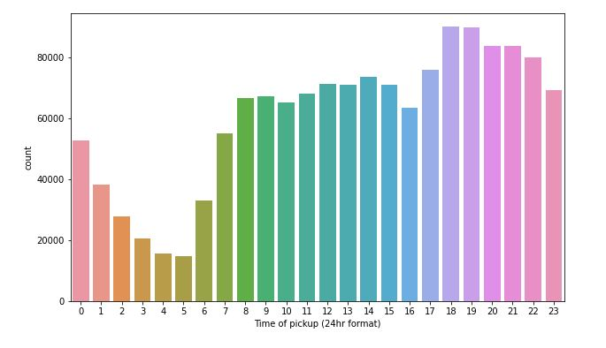
Analysis of pickup hour

Slide 21
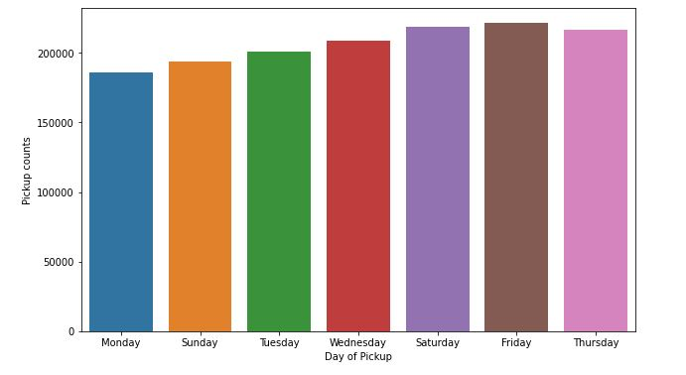
Analysis of weekday

Slide 22
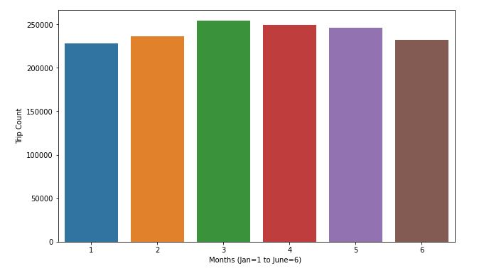
Analysis of month

Slide 23
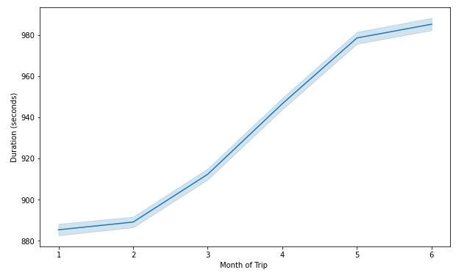
Analysis of month with trip duration

Slide 24
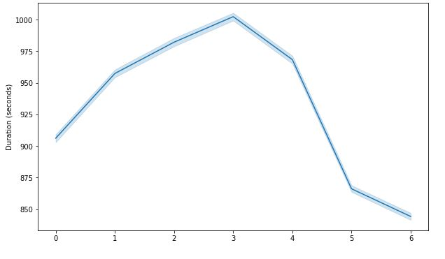
Analysis of weekday with trip duration

Slide 25
Challenges
Data set is huge with around 1.5million data details.
Challenging to identify and fit the right model for tha data
We were unable to do visualisation easily due to bulk and running models were taking lot of time.
Some geo point locations were not easy to observe.

Slide 26
CONCLUSION
Most of the trips durations took 10-30 mins to complete.
Trip duration on thursday is longest among all days.
Highest amount of trips were taken by a single passenger and large group of people travelling together is rare compared to single passenger.
Evenings are the busiest and top among the all.
From February, we can see trip duration rising every month. There might be some seasonal parameters like wind/rain which can be a factor of this gradual increase in trip duration over a period.
Most of the trips are completed at a speed range of 10-20 km/h
Trips taken by both vendors not have much difference
XGbooster is the best performing model amongst all.

